Slide 1


Combinatorial Optimization
Bo Liu,
Professor,
James Watt School of Engineering,
University of Glasgow, UK

Slide 2
Basic Concepts of Combinatorial Optimization

Slide 3





What is the Combinatorial Optimization (CO)?
Combinatorial Optimization (CO)
A field in mathematical optimization
Finding an optimal object from a finite set of objects, where the set of feasible solutions is discrete or can be reduced to a discrete set
Example: find the shortest path from home (1) to office (5)
The problem is represented on a graph with places and distances. The red line is the shortest path.
3
5
1
5
3
4
2
4
4
2
2
1

Slide 4
What is the Combinatorial Optimization (CO)?
Combinatorial Optimization (CO) vs Real-value Optimization (RO)
Decision variables:
CO: discrete in nature
RO: any real value within a specified range
Objectives:
CO: finding the best combination or permutation of items from a finite set, e.g., scheduling activities, allocating resources.
RO: finding the best values of variables, e.g., determining the optimal parameters of a system.

Slide 5

Traveling Salesman Problem (TSP)
Traveling Salesman Problem (TSP)
A salesman needs to go to several cities to sell commodities.
How to select the travel route to minimize the total travel?
In what order should the salesman visit these cities to minimize the distance traveled (cost)?
1
2
3
4
Notes:
The salesman starts from one city and needs to go through all cities before returning to the place of departure.

Slide 6
Formulation of TSP
Traveling Salesman Problem (TSP)
Representation of a tour? Permutation
e.g.: 4 cities: (1, 4, 3, 2) means: 1→ 4 → 3 → 2 → 1
Generally, p={p(1), p(2) , …, p(n), p(1) }means:
p(1)→ p(2) → …→ p(n) → p(1)
where p(n) is the nth city to vist
The length of tour (Objective function)
$$L(p)=d_{p(1),p(2)}+d_{p(2),p(3)}+⋯+d_{p(n−1),p(n)}+d_{p(n),p(1)}$$

Slide 7
Formulation of TSP
Traveling Salesman Problem (TSP)
TSP is defined as:
Look for a permutation vector in to minimize
Objective (Cost) function
minimize
Search space

Slide 8
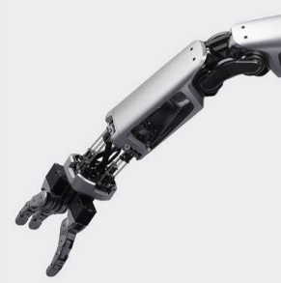
Applications Of TSP
Traveling Salesman Problem (TSP)
Robot control
Which order should the robotic arm to use in order to minimize the drilling time?
An embedded system containing the optimization algorithm.
Robot arm
Notes:
A robot arm is used to drill n screws in a metal sheet.

Slide 9
Knapsack Problem (KP)
Knapsack Problem (KP)
You have discovered a treasure trove, full of various precious treasures
However, you only have one knapsack and it only hold a fixed weight of treasures
Each treasure has its own value and weight
You need to select the optimal loading plan in order to maximize the value of the treasures inside the backpack

Slide 10
Knapsack Problem (KP)
An Example of KP
Five items with values and weights
A knapsack with a maximum capacity
$1,000
Capacity: 7 kg
1kg
$2,500
3kg
$1,500
2kg
$4,000
4kg
$2,000
2kg

Slide 11
Formulation as 0-1 programming
Binary Encoding
Each gene represents one item, 0 = not carry, 1 = carry
Solution 1:
( 0 1 0 1 0 )
Solution 2:
( 1 1 0 0 1 )
Solution 3:
( 0 0 1 1 1 )
$1,500 + $2,500 = $4,000,
2kg+3kg=5kg<7kg
$1,000 + $1,500 + $4,000 = $7,500,
1kg+2kg+4kg=7kg=7kg
$2,000 + $2,500 + $4,000 = $8,500,
2kg+3kg+4kg=9kg>7kg

Slide 12
GA for 0-1 combinatorial optimization

Slide 13
A brief review of GA
Population: a set of candidate solutions
Selection: select fittest solutions to be parents for the next generation
Crossover: exchange information from two parent solutions to produce new solutions
Mutation: modify an existing solution
Population at generation t
Parent Set
Population at generation t+1
Crossover
Mutation
Selection

Slide 14
Knapsack Problem without constraints
Knapsack problem without constraint
Given: five items with different values and weights
Objective: carry the set of items with maximum values
Constraints: a large knapsack without weight limitation (not considered at this moment)
$1,000
1kg
$2,500
3kg
$1,500
2kg
$4,000
4kg
$2,000
2kg

Slide 15
Binary encoding
Binary to real number conversion in real-value optimization
Binary representation
Real value
decoding
0 0 1 1
3
encoding
What if the decision variables are 0-1 ?
Directly use binary representation
0 0 1 1

Slide 16
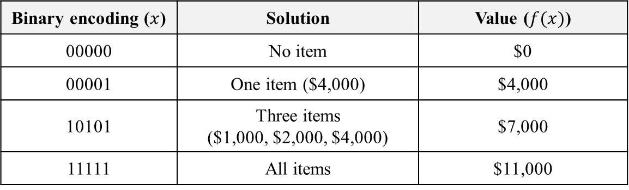
Binary encoding
Binary encoding for knapsack problem
Each gene represents whether carry the corresponding item or not
1 0 1 0 1
$2,000
$2,500
$4,000
$1,000
$1,500
2kg
2kg
3kg
4kg
1kg
Binary encoding ($x$) | Solution | Value ($f(x)$)
00000 | No item | $0
00001 | One item ($4,000) | $4,000
10101 | Three items ($1,000, $2,000, $4,000) | $7,000
11111 | All items | $11,000

Slide 17
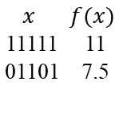
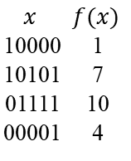
GA with binary encoding
GA with binary encoding for KP
A population with 4 solutions
Values are in $k
The optimal solution is: load all the items (encoding 11111) with a cost $11k
Current Population
Selected Parents
New Solutions
New Population
Replacement
$$x$$ | $$f(x)$$
10000 | 1
10101 | 7
01111 | 10
00001 | 4
Selection
$$x$$ | $$f(x)$$
11111 | 11
01101 | 7.5
10101
01111
11111
01101
Crossover
Mutation
101|01
011|11
101|11
011|01
11111
01101

Slide 18
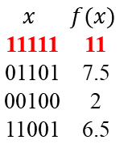
GA with binary encoding
GA with binary encoding for KP
A population with 4 solutions
Values are in $k
The optimal solution is: load all the items (encoding 11111) with a cost $11k
Current Population
Selected Parents
New Solutions
New Population
Replacement
$$x$$ | $$f(x)$$
10000 | 1
10101 | 7
01111 | 10
00001 | 4
Selection
$$x$$ | $$f(x)$$
11111 | 11
01101 | 7.5
00100 | 2
11001 | 6.5
10000
00001
00100
11001
Crossover
Mutation
100|00
000|01
000|00
100|01
00100
11001

Slide 19
Handling constraints
The knapsack problem has a constraint
Given: five items with different values and weights
Objective: carry the set of items with maximum values
Constraints: a knapsack with maximum capacity 7 kg
$1,000
1kg
$2,500
3kg
$1,500
2kg
$4,000
4kg
$2,000
2kg
capacity 7 kg

Slide 20
Repairment method
Repairment Method: value-to-weight ratio (v2w) instead of value
Calculate value-to-weight ratio for each item
$1,000
v2w: 1,000
1kg
$2,500
1kg
v2w: 833
3kg
3kg
$1,500
v2w: 750
2kg
$4,000
2kg
v2w: 1000
4kg
4kg
$2,000
v2w: 1,000
2kg
2kg

Slide 21
Repairment method
Repairment method: value-to-weight ratio (v2w) instead of value
Suppose we have a binary vector 0 1 0 1 1. The total weight (9kg) is larger than the capacity (7kg).
Sort the three items based on their v2w in descending order.
If constraint is violated, take out the one with the worst v2w. Repeat until the constraint is satisfied.
Selected items
Token out item
v2w: 1,000
v2w: 833
v2w: 750
4kg
3kg
2kg

Slide 22
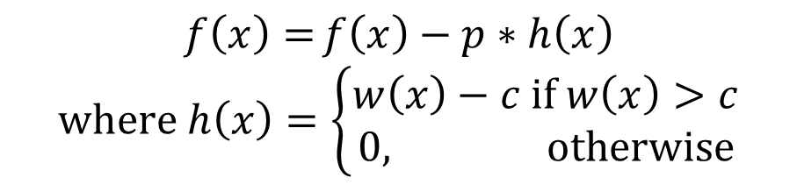
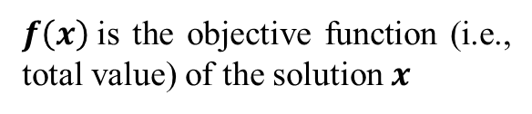
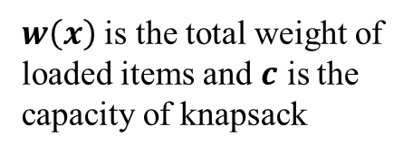
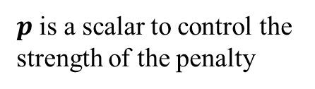
Penalty function method
Penalty function method
Transform to unconstrained problem using following function
$f\left(x\right)$is the objective function (i.e., total value) of the solution $x$
$p$ is a scalar to control the strength of the penalty
$$f\left(x\right)={f\left(x\right)−p∗h\left(x\right)}$$
$$where h\left(x\right)=\left\{\begin{aligned}w\left(x\right)−c if w\left(x\right)>c \\ 0, otherwise\end{aligned}\right.$$
$w\left(x\right)$ is the total weight of loaded items and $c$ is the capacity of knapsack
The penalty function

Slide 23
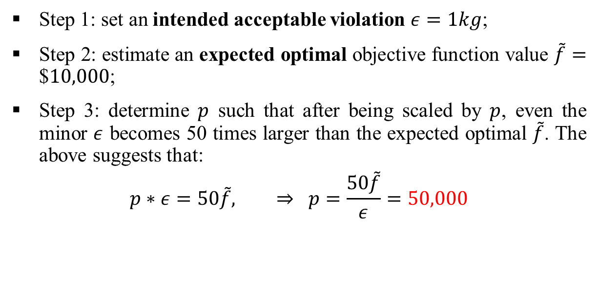
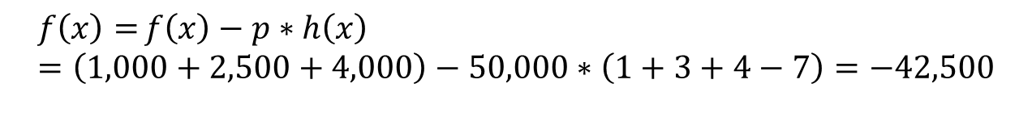
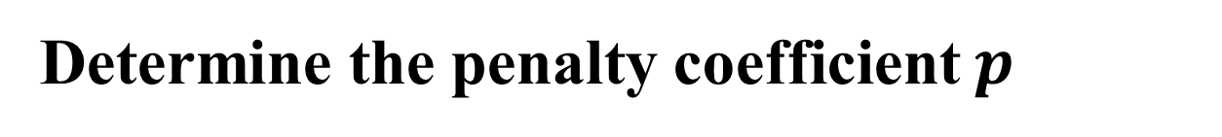
Penalty function method
Determine the penalty coefficient $p$
Step 1: set an intended acceptable violation $ε=1kg$;
Step 2: estimate an expected optimal objective function value $\tilde{f}=\text{\$}10,000$;
Step 3: determine $p$ such that after being scaled by $p$, even the minor $ε$ becomes 50 times larger than the expected optimal $\tilde{f}$. The above suggests that:
$$p∗ε=50\tilde{f}, ⇒ p=\frac{50\tilde{f}}{ε}=50,000$$
An Example
for a solution $x$ = 10011
$$f\left(x\right)={f\left(x\right)−p∗h\left(x\right)}=\left(1,000+2,500+4,000\right)−50,000∗\left(1+3+4−7\right)=−42,500$$

Slide 24
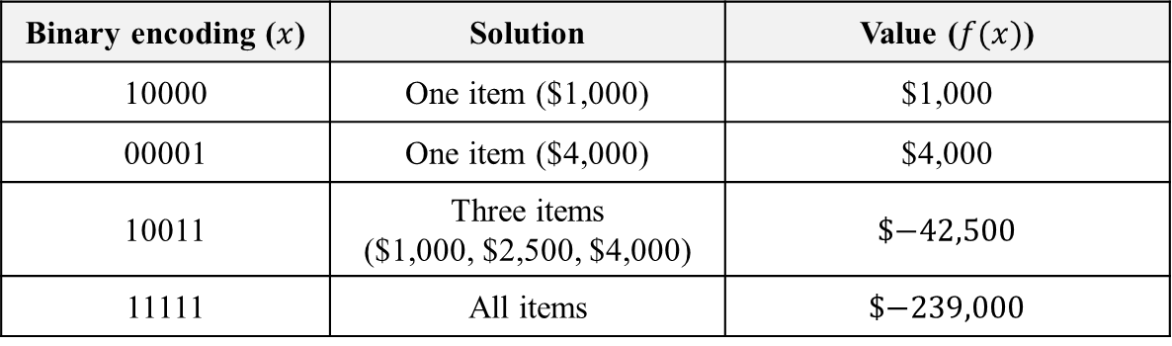
Penalty function method
Penalty function method
An Example
The penalty scalar $p$ = 50,000, for a solution $x$ = 10011
$$f\left(x\right)={f\left(x\right)−p∗h\left(x\right)}=\left(1,000+2,500+4,000\right)−50,000∗\left(1+3+4−7\right)=−42,500$$
Binary encoding ($x$) | Solution | Value ($f(x)$)
10000 | One item ($1,000) | $1,000
00001 | One item ($4,000) | $4,000
10011 | Three items ($1,000, $2,500, $4,000) | $$−42,500$
11111 | All items | $$−239,000$

Slide 25
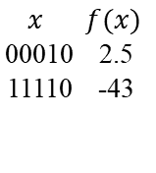
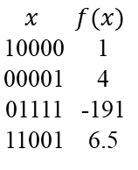
GA with binary encoding for KP with constraints
GA with binary encoding for KP with constraint
A population with 4 solutions
Values are in $k
The optimal feasible solution: 10101 with a value $7k
Current Population
Selected Parents
New Solutions
New Population
Replacement
$$x$$ | $$f(x)$$
10000 | 1
00001 | 4
01111 | -191
11001 | 6.5
Selection
$$x$$ | $$f(x)$$
00010 | 2.5
11110 | -43
10000
01111
00010
11110
Crossover
Mutation
1|0000
0|1111
0|0000
1|1111
00010
11110

Slide 26
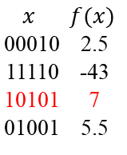
GA with binary encoding for KP with constraints
GA with binary encoding for KP with constraint
A population with 4 solutions
Values are in $k
The optimal feasible solution: 10101 with a value $7k
Current Population
Selected Parents
New Solutions
New Population
Replacement
$$x$$ | $$f(x)$$
10000 | 1
00001 | 4
01111 | -191
11001 | 6.5
Selection
$$x$$ | $$f(x)$$
00010 | 2.5
11110 | -43
10101 | 7
01001 | 5.5
00001
11001
10101
01001
Crossover
Mutation
0|0001
1|1001
1|0001
0|1001
10101
01001

Slide 27
MATLAB implementation
Framework of MATLAB implementation
Example.m
GA.m
Crossover.m
Mutation.m
Selection.m

Slide 28
MATLAB files
MATLAB files
ExampleKP.m
Entrance of program, a five-item 0-1 Knapsack problem example
GA_01.m
GA code with binary encoding
Crossover01.m
Single-point crossover function
Mutation.m
Mutation function
Selection.m
Tournament selection function

Slide 29
Instance and parameter settings
Instance and parameter settings
% KP instance:
values = [1000, 1500, 2000, 2500, 4000]; % set values of items
weights = [1, 2, 2, 3, 4]; % set weights of items
maxWeight = 7; % Set maximum weight allowed in the knapsack maxWeight = 7;
% Parameter settings for GA
populationSize = 50; % population size of GA
numGenerations = 50; % number of generations of GA
mutationRate = 0.05; % mutation rate of GA
tournamentSize = 2; % Size of tournament selection
weight_penalty = 2000; % Weight penalty for excess weight

Slide 30
Initialization
Initialization
% Initialization
n = length(values);
population = zeros(populationSize, n);
% Generate initial population randomly
for i = 1:populationSize
population(i, :) = randi([0, 1], 1, n);
end
% Calculate fitness for each individual in the population
fitness = calculateFitness(population, values, weights, maxWeight, weight_penalty);

Slide 31
GA main loop
Main loop
% Main loop
for gen = 1:numGenerations
for i =1:populationSize
% Select parents for reproduction using tournament selection
parent1 = Selection(population, fitness, tournamentSize);
parent2 = Selection(population, fitness, tournamentSize);
% Perform crossover and mutation to create new offspring
offspring1 = Crossover01(parent1,parent2);
% Mutation
if rand < mutationRate
offspring1 = Mutation(offspring1);
end
% Perform crossover and mutation to create new offspring
offspring2 = Crossover01(parent2,parent1);
% Mutation
if rand < mutationRate
offspring2 = Mutation(offspring2);
end
new_solutions = [offspring1; offspring2];
new_fitness = calculateFitness(new_solutions, values, weights, maxWeight, weight_penalty);
% Add offsprings into population
population = [population; new_solutions];
fitness = [fitness; new_fitness];
% Delete solution from population using tournament selection
[population,fitness] = Update_population(population, fitness, tournamentSize);
% Find the best fitness and corresponding solution
[bestFitness, bestIndex] = max(fitness);
bestSolution = population(bestIndex, :);
end
end

Slide 32
Constraint handling
Fitness Calculation and Constraint Handling
% Function to calculate the fitness of each individual in the population
function fitness = calculateFitness(population, values, weights, maxWeight, weight_penalty)
populationSize = size(population, 1);
fitness = zeros(populationSize, 1);
for i = 1:populationSize
selectedItems = logical(population(i, :));
totalWeight = weights * selectedItems';
fitness(i) = values * selectedItems';
if (totalWeight > maxWeight)
fitness(i) = fitness(i) - weight_penalty*(totalWeight-maxWeight);
end
end
end

Slide 33
Crossover & Mutation
Crossover
% Function for crossover (Single Point Crossover)
function offspring = crossover(parent1, parent2)
n = length(parent1);
crossoverPoint = randi(n-1);
offspring = [parent1(1:crossoverPoint), parent2(crossoverPoint+1:end)];
end
Mutation
% Function for mutation (flip one random position)
function mutatedChild = Mutation(child)
num = length(child);
mutatedChild = child;
% Randomly select one position to flip
swapPos1 = randi(num);
% flip
mutatedChild(swapPos1:end) = 1 - mutatedChild(swapPos1:end);
end

Slide 34
Tournament selection
Tournament Selection
Step 1: Randomly select T (tournament size) candidates from population for the tournament
Step 2: Select the individual with the highest fitness as the winner of the tournament
Step 3: Repeat the tournament process until you have selected the desired number of winners
Select the
tournament group
A
Select the winner
B
C
A
D
A
D
E
F

Slide 35
Selection
Tournament selection
% Function for tournament selection
function selectedIndividual = Selection(population, fitness, tournamentSize)
numIndividuals = size(population, 1);
selectedIndividual = zeros(1, size(population, 2));
bestFitness = Inf;
for i = 1:tournamentSize
randomIndex = randi(numIndividuals);
if fitness(randomIndex) < bestFitness
bestFitness = fitness(randomIndex);
selectedIndividual = population(randomIndex, :);
end
end
end

Slide 36
GA for Traveling Salesman Problem (TSP)

Slide 37
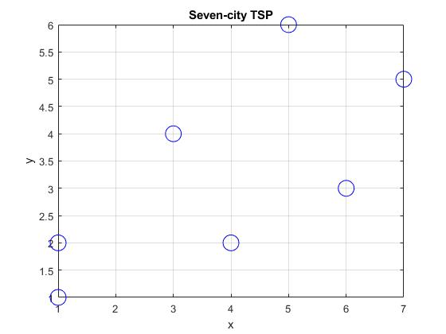
TSP: an example
Suppose we have a TSP with seven cities
Their coordinates are as follows:
1 = {1, 1}
2 = {1, 2}
3 = {3, 4}
4 = {4, 2}
5 = {5, 6}
6 = {6, 3}
7 = {7, 5}

Slide 38
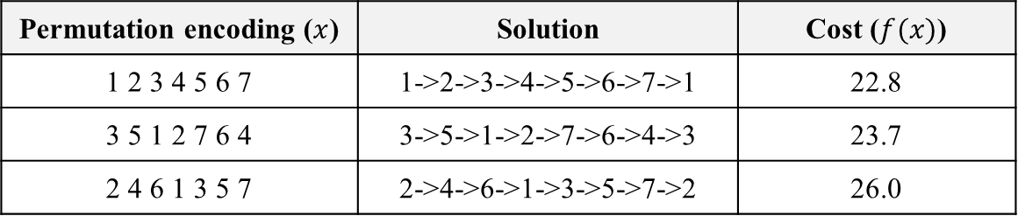
Permutation encoding
Permutation encoding for TSP
Each gene represents one city
Permutation encoding: The sequence represents the order of visiting cities
Solution: The corresponding solution is a close loop specified by the sequence
Cost: The cost is the total distance of loop
Permutation encoding ($x$) | Solution | Cost ($f(x)$)
1 2 3 4 5 6 7 | 1->2->3->4->5->6->7->1 | 22.8
3 5 1 2 7 6 4 | 3->5->1->2->7->6->4->3 | 23.7
2 4 6 1 3 5 7 | 2->4->6->1->3->5->7->2 | 26.0

Slide 39
Single-Point Crossover
Simple Single-point Crossover
Select position randomly
Generate offspring by swapping
Parent 1
3 5 1 2 7 6 4
Parent 2
1 2 3 4 5 6 7
Offspring 1
3 5 1 2 5 6 7
Offspring 2
1 2 3 4 7 6 4
Problem: duplicated nodes
3 5 1 2 5 6 7

Slide 40
Ordered crossover
Ordered crossover ensures no duplicated cities
Step 1: Choose a random subset of cities form the first parent, and copy it to the offspring
Step 2: Iterate through the second parent and copy the remaining cities in the original order, excluding the cities already in the offspring
Parent 1
3 5 1 2 7 6 4
Parent 2
1 2 3 4 5 6 7
Offspring (Step 1)
X X X 2 7 X X
Offspring (Step 2)
1 3 4 2 7 5 6

Slide 41
Mutation
Mutation
Step 1: Randomly choose two positions for a candidate solution
Step 2: Swap two positions to generate a new offspring
Candidate
Offspring
3 4 5 2 7 6 1
3 4 5 2 1 6 7

Slide 42
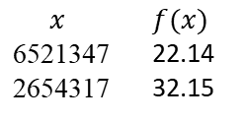
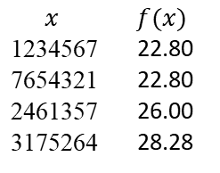
GA for TSP
Search Space
[1, 2, 3, 4, 5, 6, 7]
[5, 7, 2, 6, 1, 4, 3]
[2, 4, 6, 1, 3, 5, 7]
……
[7, 6, 5, 4, 3, 2, 1]
[3, 1, 7, 5, 2, 6, 4]
Current Population
Selected Parents
New Solutions
New Population
Replacement
$$x$$ | $$f(x)$$
1234567 | 22.80
7654321 | 22.80
2461357 | 26.00
3175264 | 28.28
Selection
$$x$$ | $$f(x)$$
6521347 | 22.14
2654317 | 32.15
7654321
2461357
6521347
2654317
Crossover
Mutation
765|43|21
246|13|57
6541327
2614357
6521347
2654317

Slide 43
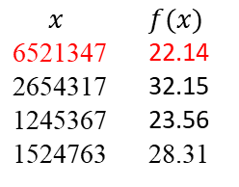
GA for TSP
Search Space
[1, 2, 3, 4, 5, 6, 7]
[5, 7, 2, 6, 1, 4, 3]
[2, 4, 6, 1, 3, 5, 7]
……
[7, 6, 5, 4, 3, 2, 1]
[3, 1, 7, 5, 2, 6, 4]
Current Population
Selected Parents
New Solutions
New Population
Replacement
$$x$$ | $$f(x)$$
1234567 | 22.80
7654321 | 22.80
2461357 | 26.00
3175264 | 28.28
Selection
$$x$$ | $$f(x)$$
6521347 | 22.14
2654317 | 32.15
1245367 | 23.56
1524763 | 28.31
1234567
3175264
1245367
1524763
Crossover
Mutation
123|45|67
317|52|64
1345267
1724563
1245367
1524763

Slide 44
MATLAB files
MATLAB files
ExampleTSP.m
Entrance of program, a seven-city TSP example
GA_TSP.m
GA code with permutation encoding
CrossoverOX.m
Ordered crossover function
Mutation.m
Mutation function
Selection.m
Tournament selection function

Slide 45
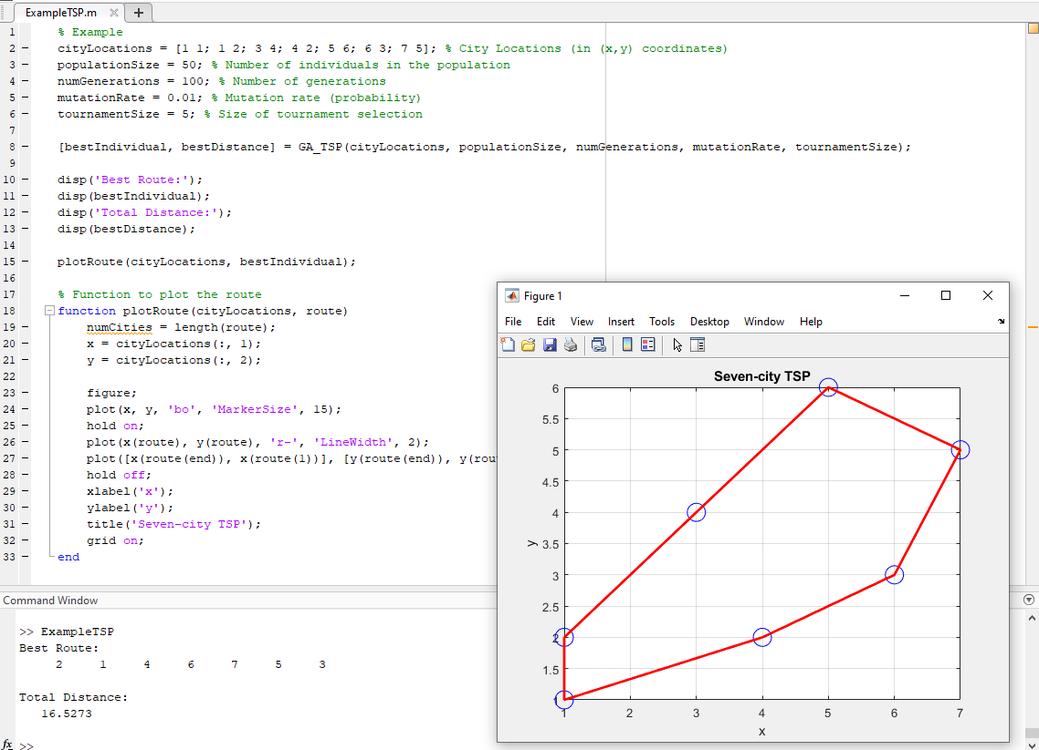
Illustration

Slide 46
TSP instance and parameter settings
TSP instance and parameter settings
% TSP instance
cityLocations = [1 1; 1 2; 3 4; 4 2; 5 6; 6 3; 7 5]; % City Locations (in (x,y) coordinates)
% parameter settings for GA
populationSize = 50; % Number of individuals in the population
numGenerations = 50; % Number of generations
mutationRate = 0.05; % Mutation rate (probability)
tournamentSize = 2; % Size of tournament selection
% Run genetic algorithm for TSP
[bestIndividual, bestDistance] = GA_TSP(cityLocations, populationSize, numGenerations, mutationRate, tournamentSize)

Slide 47
Initialization
Initialization
% Initialize the TSP instance
numCities = size(cityLocations, 1); % Number of cities
distanceMatrix = pdist2(cityLocations, cityLocations); % Distance matrix
% Initialize the population
population = zeros(populationSize, numCities);
for i = 1:populationSize
population(i, :) = randperm(numCities);
% each individual is a permutation of length numCities
end
% Evaluate the fitness of each individual (total distance)
fitness = zeros(populationSize, 1);
for i = 1:populationSize
fitness(i) = calculateFitness(population(i, :), distanceMatrix);
end

Slide 48
Main loop
Main loop
% Main loop
for gen = 1:numGenerations
for i =1:populationSize
% Select parents for reproduction using tournament selection
parent1 = Selection(population, fitness, tournamentSize);
parent2 = Selection(population, fitness, tournamentSize);
% Perform crossover and mutation to create new offspring
offspring1 = CrossoverOX(parent1,parent2);
% Mutation
if rand < mutationRate
offspring1 = Mutation(offspring1);
end
fitness1 = calculateFitness(offspring1, distanceMatrix);
population = [population; offspring1];
fitness = [fitness; fitness1];
% Perform crossover and mutation to create new offspring
offspring2 = CrossoverOX(parent2,parent1);
% Mutation
if rand < mutationRate
offspring2 = Mutation(offspring2);
end
fitness2 = calculateFitness(offspring2, distanceMatrix);
population = [population; offspring2];
fitness = [fitness; fitness2];
% Update the population using tournament selection
[population,fitness] = Update_population(population, fitness, tournamentSize);
% Find the best fitness and corresponding solution
[bestDistance, bestIndex] = min(fitness);
bestIndividual = population(bestIndex, :);
end
end

Slide 49
Ordered crossover
Ordered crossover
% Function for ordered crossover
function child = orderedCrossover(parent1, parent2)
numCities = length(parent1);
child = zeros(1, numCities);
% Randomly select a subset from parent 1
subsetStart = randi([1, numCities - 1]);
subsetEnd = randi([subsetStart, numCities]);
subset = parent1(subsetStart:subsetEnd);
child(subsetStart:subsetEnd) = subset; % Fill the child with the subset from parent 1
% Fill the remaining positions with the genes from parent 2
j = 1;
for i = 1:numCities
if child(i) == 0
while ismember(parent2(j), subset)
j = j + 1;
end
child(i) = parent2(j);
j = j + 1;
end
end
end

Slide 50
Mutation
Mutation
% Function for mutation (swap two random cities)
function mutatedChild = mutate(child)
numCities = length(child);
mutatedChild = child;
% Randomly select two positions to swap
swapPos1 = randi(numCities);
swapPos2 = randi(numCities);
% Swap the cities
temp = mutatedChild(swapPos1);
mutatedChild(swapPos1) = mutatedChild(swapPos2);
mutatedChild(swapPos2) = temp;
end

Slide 51
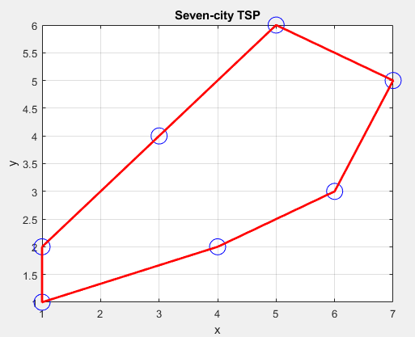
Display the best solution
Display the best solution
% Display the best route and the total distance
disp('Best Route:');
disp(bestIndividual);
disp('Total Distance:');
disp(bestDistance);
% Plot the best route
plotRoute(cityLocations, bestIndividual);
% Function to plot the route
function plotRoute(cityLocations, route)
numCities = length(route);
x = cityLocations(:, 1);
y = cityLocations(:, 2);
figure;
plot(x, y, 'bo', 'MarkerSize', 10);
hold on;
plot(x(route), y(route), 'r-', 'LineWidth', 2);
plot([x(route(end)), x(route(1))], [y(route(end)), y(route(1))], 'r-', 'LineWidth', 2);
hold off;
xlabel('x');
ylabel('y');
title('TSP Solution');
grid on;
end

Slide 52
Thanks!
Notes:
As in slide

